Slide 1
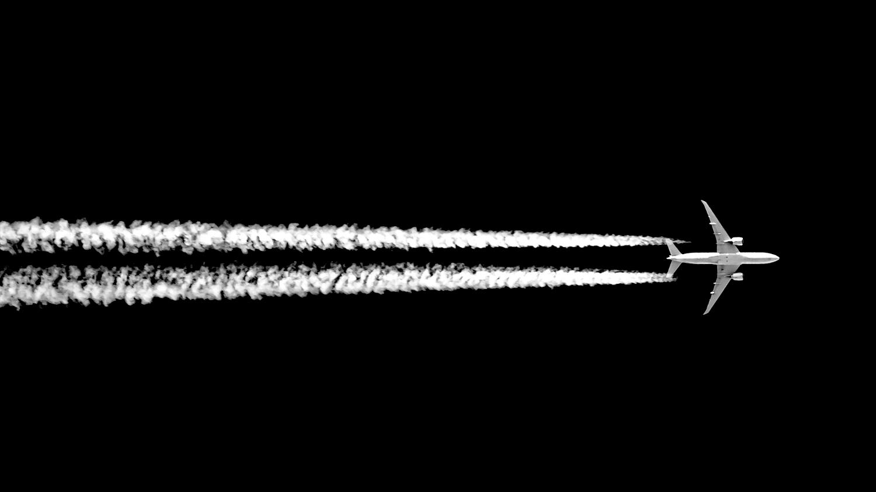
So you want to put a neural network on an airplane…
Darren Cofer | Principal Fellow
AI Assurance workshop
10 August 2023
Notes:
Challenges
Certification guidance
Applications

Slide 2
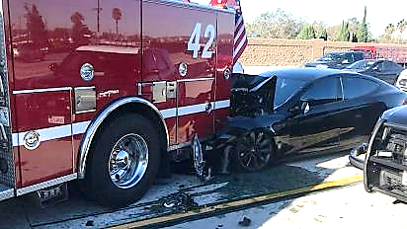
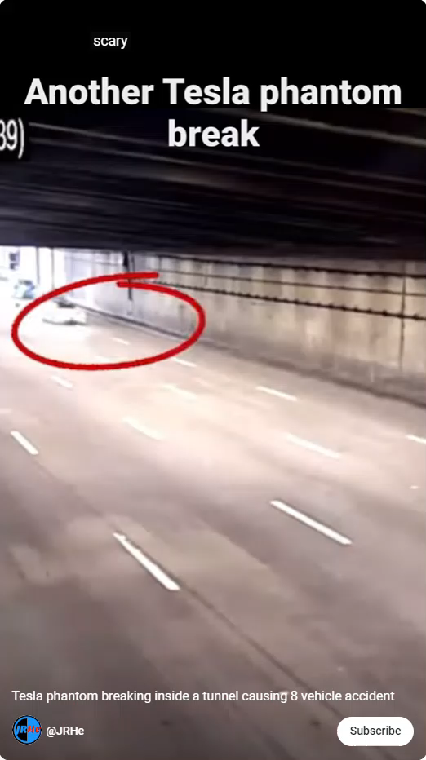
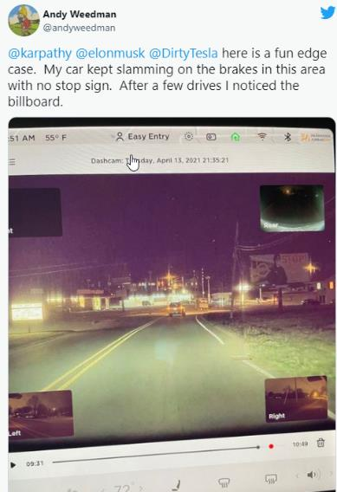
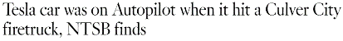

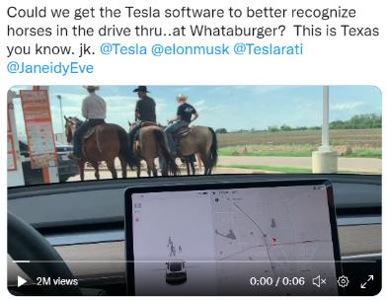
What could possibly go wrong?
brake
https://www.latimes.com/business/story/2019-09-03/tesla-was-on-autopilot-when-it-hit-culver-city-fire-truck-ntsb-finds
https://twitter.com/Cbiggs90/status/1519821916189741057
https://twitter.com/andyweedman/
status/1382459653863378944

Slide 3
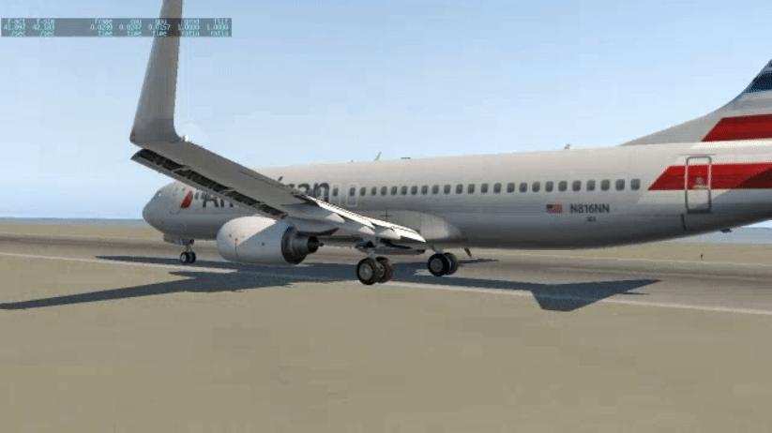
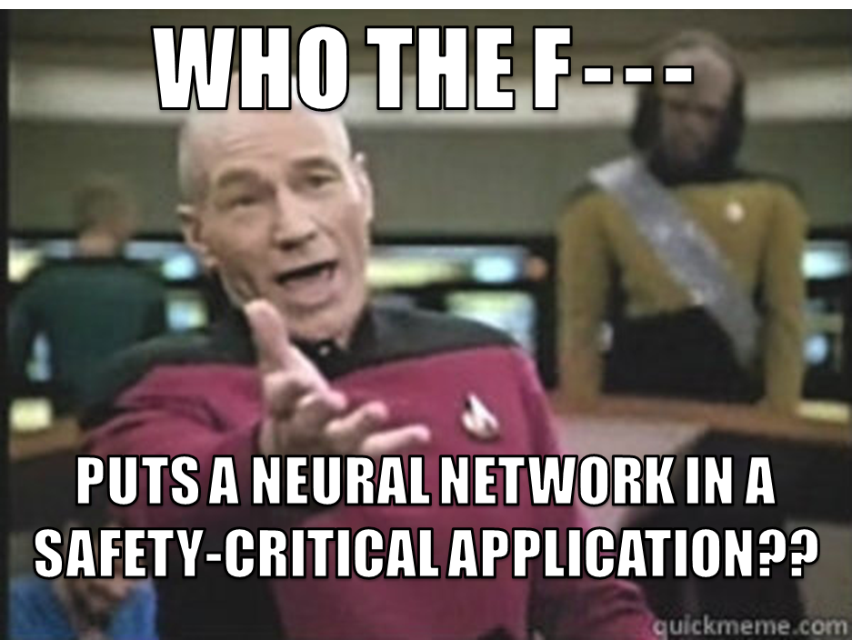
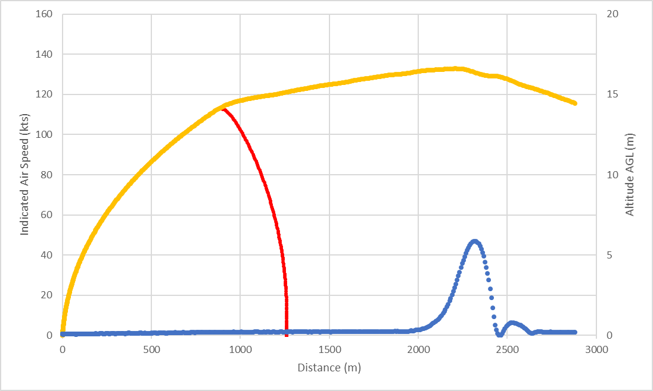
What could possibly go wrong?
Aviation Edition
Reject
V₁
Engine fault
End of runway
ENGINE FAULT AT 110 KTS
NN trained using reinforcement learning to make reject takeoff (RTO) decision for 737 aircraft (DARPA Assured Autonomy project)

Slide 4


Slide 5
Why?
Increasing automation of pilot tasks
Recovery and continued increase of demand for commercial air travel
Supply chain demands for shipping goods and materials by cargo carriers
New demands for transportation (both speed and capacity) in high-density urban areas
Shortage of trained pilots for the foreseeable future
eMCO, RCO, SPO… full autonomy?
Save computational resources in onboard embedded systems
Gigantic look-up tables (memory)
Complex optimization functions (CPU time)

Slide 6
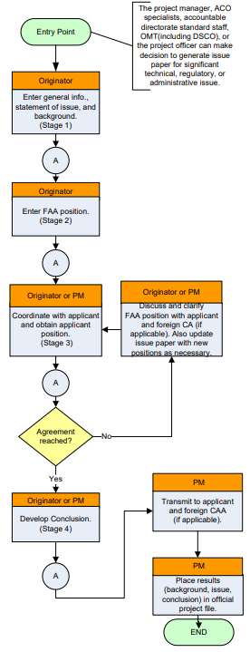

What’s different with ML?
Why can’t we just do what we’ve always done for certification?
FAA has determined that AI/ML technologies are “new and novel”
This means that they cannot be approved based on existing standards and means of compliance
Approval can be obtained using the Issue Paper process in accordance with AC 20-166A to determine acceptable Method of Compliance

Slide 7

Assurance Challenges for Machine Learning
Requirements
ML functional requirements are often imprecise (image classification)
Large labeled training/test datasets are more important
Verification
Traditional assurance (DO-178C) relies on requirements-based test cases with structural coverage metrics to assess completeness
Implementation
Design intent usually cannot be inferred from examination of design artifacts
Neither design elements nor implementation code are traceable to requirements
Structural coverage metrics are unable to detect unintended behavior in response to novel inputs
Implementation
Verification
Requirements
https://xkcd.com/1838/

Slide 8
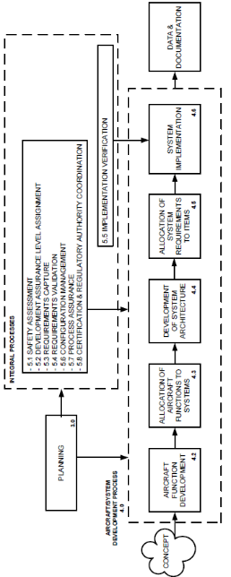
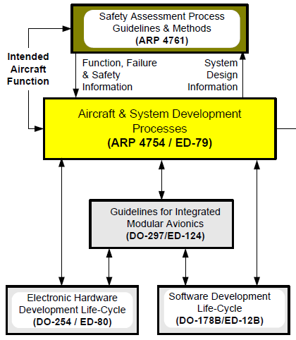
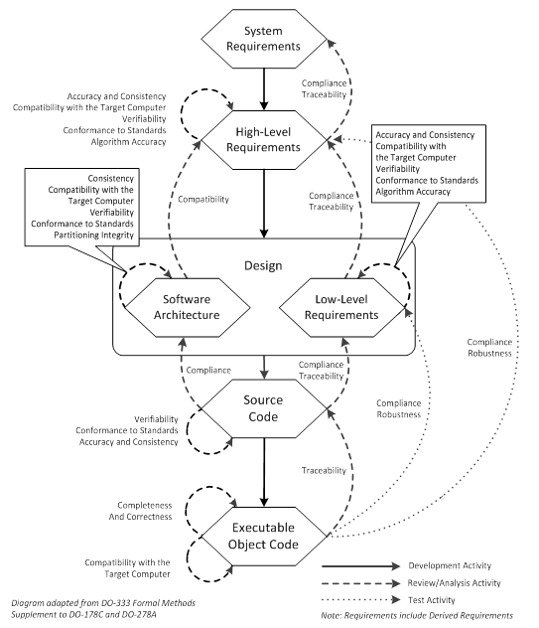
Certification Challenges
Mostly
Unchanged
Machine
Learning Magic
Training and Test Data
Gap
Model Design and Training
ML Model
DO-331?
Mostly
Unchanged
Means of compliance with airworthiness regulations

Slide 9
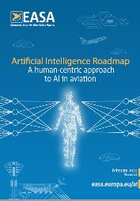
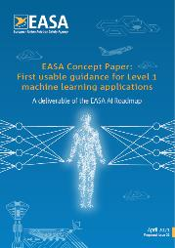
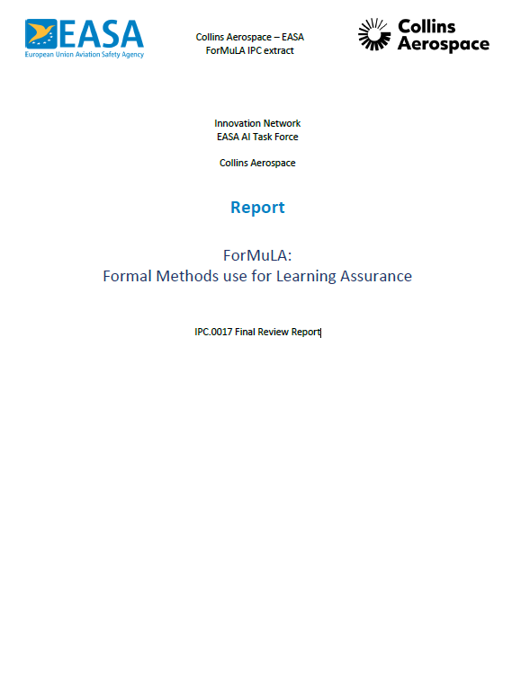

EASA Approach to ML

Slide 10
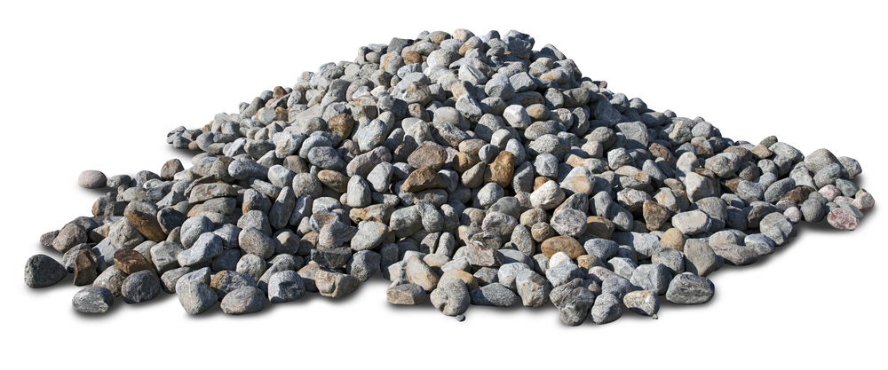
FAA Approach to ML
Technology is evolving, standardization is premature
Evaluate specific projects from applicants

Slide 11

SAE G34 / EUROCAE WG-114
ARP6983 : Process Standard for Development and Certification / Approval of Aeronautical Safety-Related Products Implementing AI
Learning Process
Use subsystem requirements to define Operational Design Domain (ODD) and training/test datasets
Data generation/management
Data is complete and representative relative to ODD
Model training to achieve performance target
Verification of Trained Model
Show absence of unintended behavior
Generalization
Stability
Robustness
Inference Model Implementation
Implement model functionality using traditional methods
Verification using traditional methods
Inference Model Integration/Verification
Show that implementation of inference model preserves properties of trained model
Requirements verification
Performance verification
Robustness on target hardware
Compatibility with target hardware
Directly related to unintended behavior

Slide 12
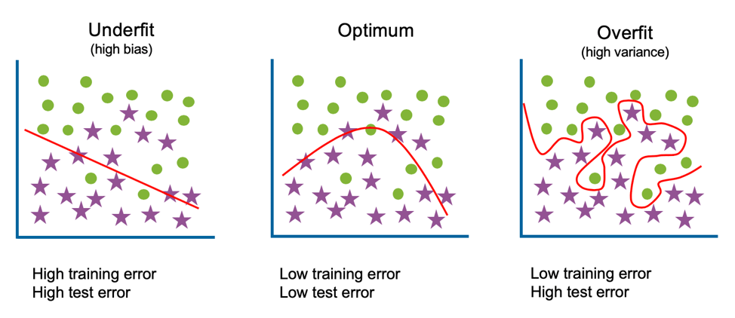
Unintended behaviors
Generalization
How does system respond to novel/unexpected inputs that were not included in training dataset?
In ODD but “between” concrete training points
Stability
How does system respond to perturbations around training data points?
Can small input disturbances result in large output deviations?
Related to adversarial inputs
Robustness
How does system respond to inputs near boundary of ODD?
Similar to abnormal inputs (robustness test cases in DO-178C)
Performance vs. Generalization
https://www.codingninjas.com/codestudio/library/bias-variance-tradeoff

Slide 13

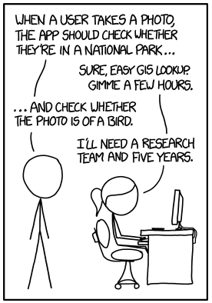
Aviation ML Applications
Perception is a strong point for ML/DNN, but also hardest to verify (size, requirements)
LOW IMPACT OF FAILURE
Detect & Avoid
Visual Landing
VISION/PERCEPTION BASED SYSTEMS
Pilot Alertness
(Warning)
Pilot Alertness (SPO)
ML not necessary (there are existing alternatives) but is used to save memory or compute time
Formal methods can be used to demonstrate absence of unintended functionality
Planning input to Pilots (Advisory)
SCALE-UP
Equipment Health Monitoring
COMPLEXITY
Runway Overrun Warning
ACAS-Xu Collision Avoidance
Optimal Flight Level
SIMPLE OPERATIONAL DOMAIN
Fuel Measurement
https://xkcd.com/1425/
CRITICALITY

Slide 14
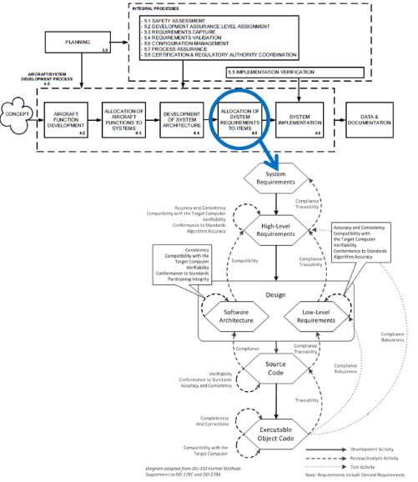
First Steps : DAL D
Software is a “black box”
Testing to show that software meets its requirements
Very little about implementation details
Nothing related to unintended function
What else might be needed?
Operational Design Domain (ODD)
Training data set
Verification data set
Basic architecture (e.g., 3-layer feed-forward neural network with tanh activation functions, trained with PyTorch)
Black
Box

Slide 15
First Steps : Simple NN
Criticality up to DAL A supported
Limited to NN with “simple” ODD (or “small” model)
Small number of well-defined scalar-valued sensor inputs with max/min range
I.e., not images
What else might be needed?
Full learning assurance process, similar to AS6983 MLDL or EASA First Usable Guidance (for DAL A-C anyway)
Rigorous Data Management Process
Demonstrations of generalization, stability, robustness
Justification for absence of unintended behavior/function (using formal methods, traditional mathematical reasoning, or extremely dense training/testing data sets)
Complex NN will not yet be able to satisfy these objectives
Detailed
Learning
Assurance
Process
(MLDL)

Slide 16

Summary
Machine learning presents unique assurance challenges in the aviation environment (mostly related to unintended behaviors)
FAA and EASA are preparing for initial proposals/applications, but with very different approaches
The SAE G34 / EUROCAE WG114 joint committee is moving forward to produce industry consensus certification guidance that is intended to address the challenges posed by AI/ML, enabling its use in increasingly autonomous aircraft
High complexity ML functions (vision/perception) will continue to be a challenge in applications that require higher levels of assurance
But we can make progress now on simple / low criticality ML function

Slide 17
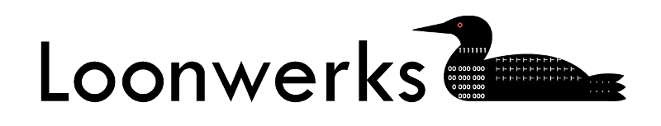
Unintended Behavior in Learning-Enabled Systems: Detecting the Unknown Unknowns
D. Cofer. Digital Avionics Systems Conference (DASC), October 2021
Flight Test of a Collision Avoidance Neural Network with Run-Time Assurance
D. Cofer, R. Sattigeri, I. Amundson, J. Babar, S. Hasan, E. Smith, K. Nukala, D. Osipychev, M. Moser, J. Paunicka, D. Margineantu, L. Timmerman, J. Stringfield. Digital Avionics Systems Conference (DASC), September 2022.
Formal Methods use for Learning Assurance (ForMuLA)
M. Baleani, A. Clavière, D. Cofer, E. DeWind, L. Di Guglielmo, O. Ferrante, G. Gentile, D. Kirov, D. Larsen, L. Mangeruca, S. Fulvio Rollini, G. Cima, R. Schneider H. Semde, G. Soudain
Collins Aerospace / EASA IPC Report
Loonwerks.com

